Slide 1


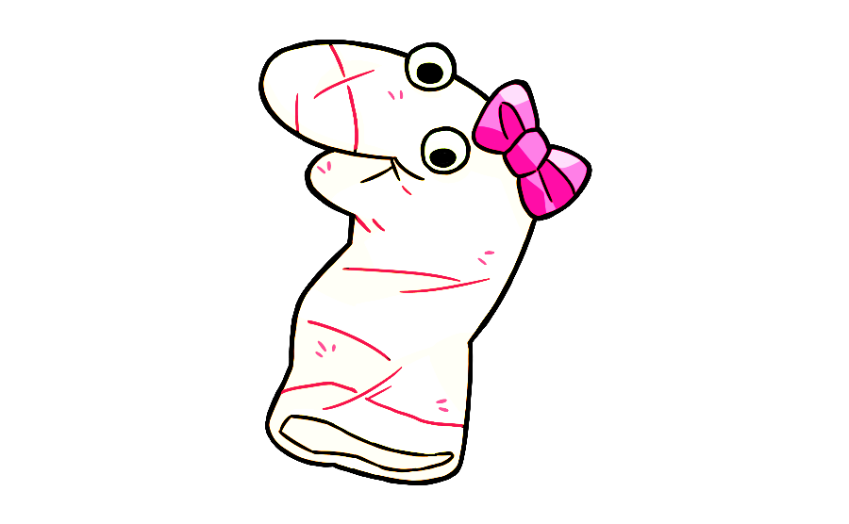
The Curious maggie

Slide 2


Welcome and thank you so much for participating in our game!
Today you are going to meet my friend Maggie. Maggie is very curious about what things are for. You and Maggie are going to look at lots of pictures together so you can teach her about what things are for. There are no right or wrong answers in the game! You can say whatever it is that you think.
Ok let’s meet Maggie first!

Slide 3
Before you teach the curious Maggie about what things are for, let’s teach Maggie some English first.

Slide 4



Maggie is learning to speak English and she has some questions for you.
Now, let’s help Maggie learn English!

Slide 5

Maggie is unsure what is right to say. Let’s hear what she says first before we help her! This is what she says:
I put socks on my feet.
I put socks on my feets.

Slide 6
Is it right or wrong for Maggie to say:
I put socks on my feet.
Please say your answer out loud. When you finish, click ”Next”.

Slide 7
Is it right or wrong for Maggie to say:
I put socks on my feets.
Please say your answer out loud. When you finish, click ”Next”.

Slide 8
Okay. This is what Maggie says:
I live in Maple Street.
I live on Maple Street.

Slide 9
Is it right or wrong for Maggie to say:
I live in Maple Street.
Please say your answer out loud. When you finish, click ”Next”.

Slide 10
Is it right or wrong for Maggie to say:
I live on Maple Street.
Please say your answer out loud. When you finish, click ”Next”.

Slide 11


Wow, Maggie has learned lots of English because of you.
Thanks for helping Maggie!

Slide 12






Now it’s time to teach Maggie about different things.
To start, click next.

Slide 13
Notes:
This is Maggie! Say high to Maggie. Hi Maggie [wiggle]. Maggie wants to learn what things are for. And today you are going to teach Maggie what different things are for. Are you ready to help Maggie? OK, let’s help Maggie!

Slide 14
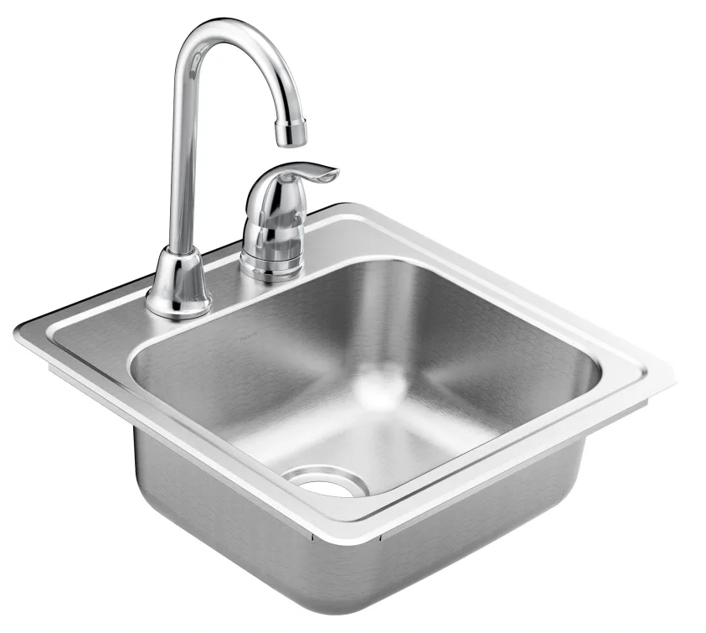
Notes:
See this [wiggle]? This is a sink! Can you tell Maggie what sinks are for?

Slide 15

Notes:
Thanks so much for helping Maggie! Let’s see the next thing!

Slide 16
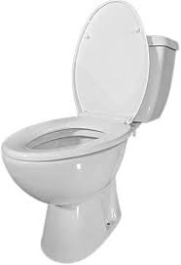
Notes:
See this [wiggle]? This is a toilet! Can you tell Maggie what toilets are for?

Slide 17
Notes:
Thanks so much for helping Maggie! Let’s see the next thing!

Slide 18
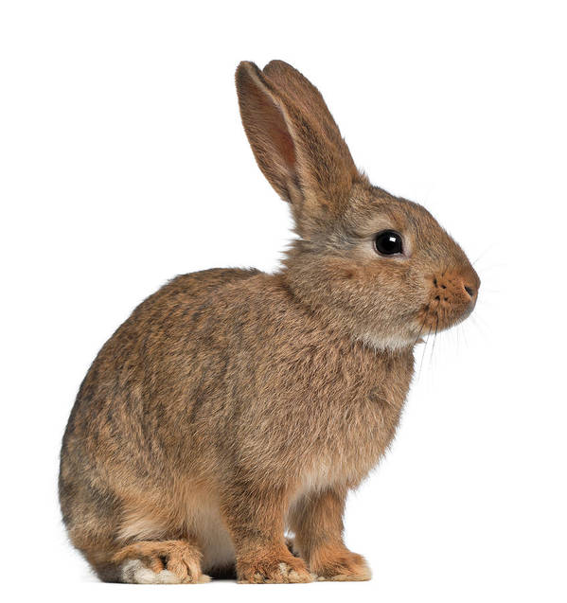
Notes:
See this [wiggle]? This is a bunny! Can you tell Maggie what bunnies are for?

Slide 19
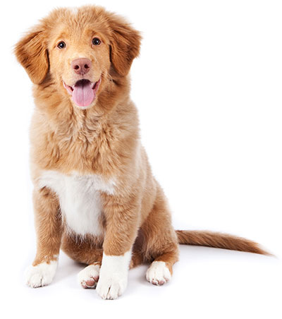
Notes:
See this [wiggle]? This is a dog! Can you tell Maggie what dogs are for?

Slide 20
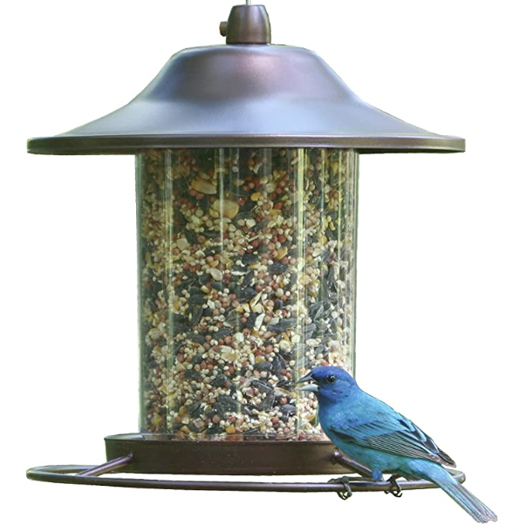
Notes:
See this [wiggle]? This is a bird feeder! Can you tell Maggie what bird feeders are for?

Slide 21
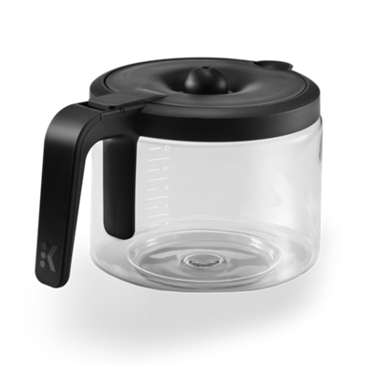
Notes:
See this [wiggle]? This is a coffee pot! Can you tell Maggie what coffee pots are for?

Slide 22
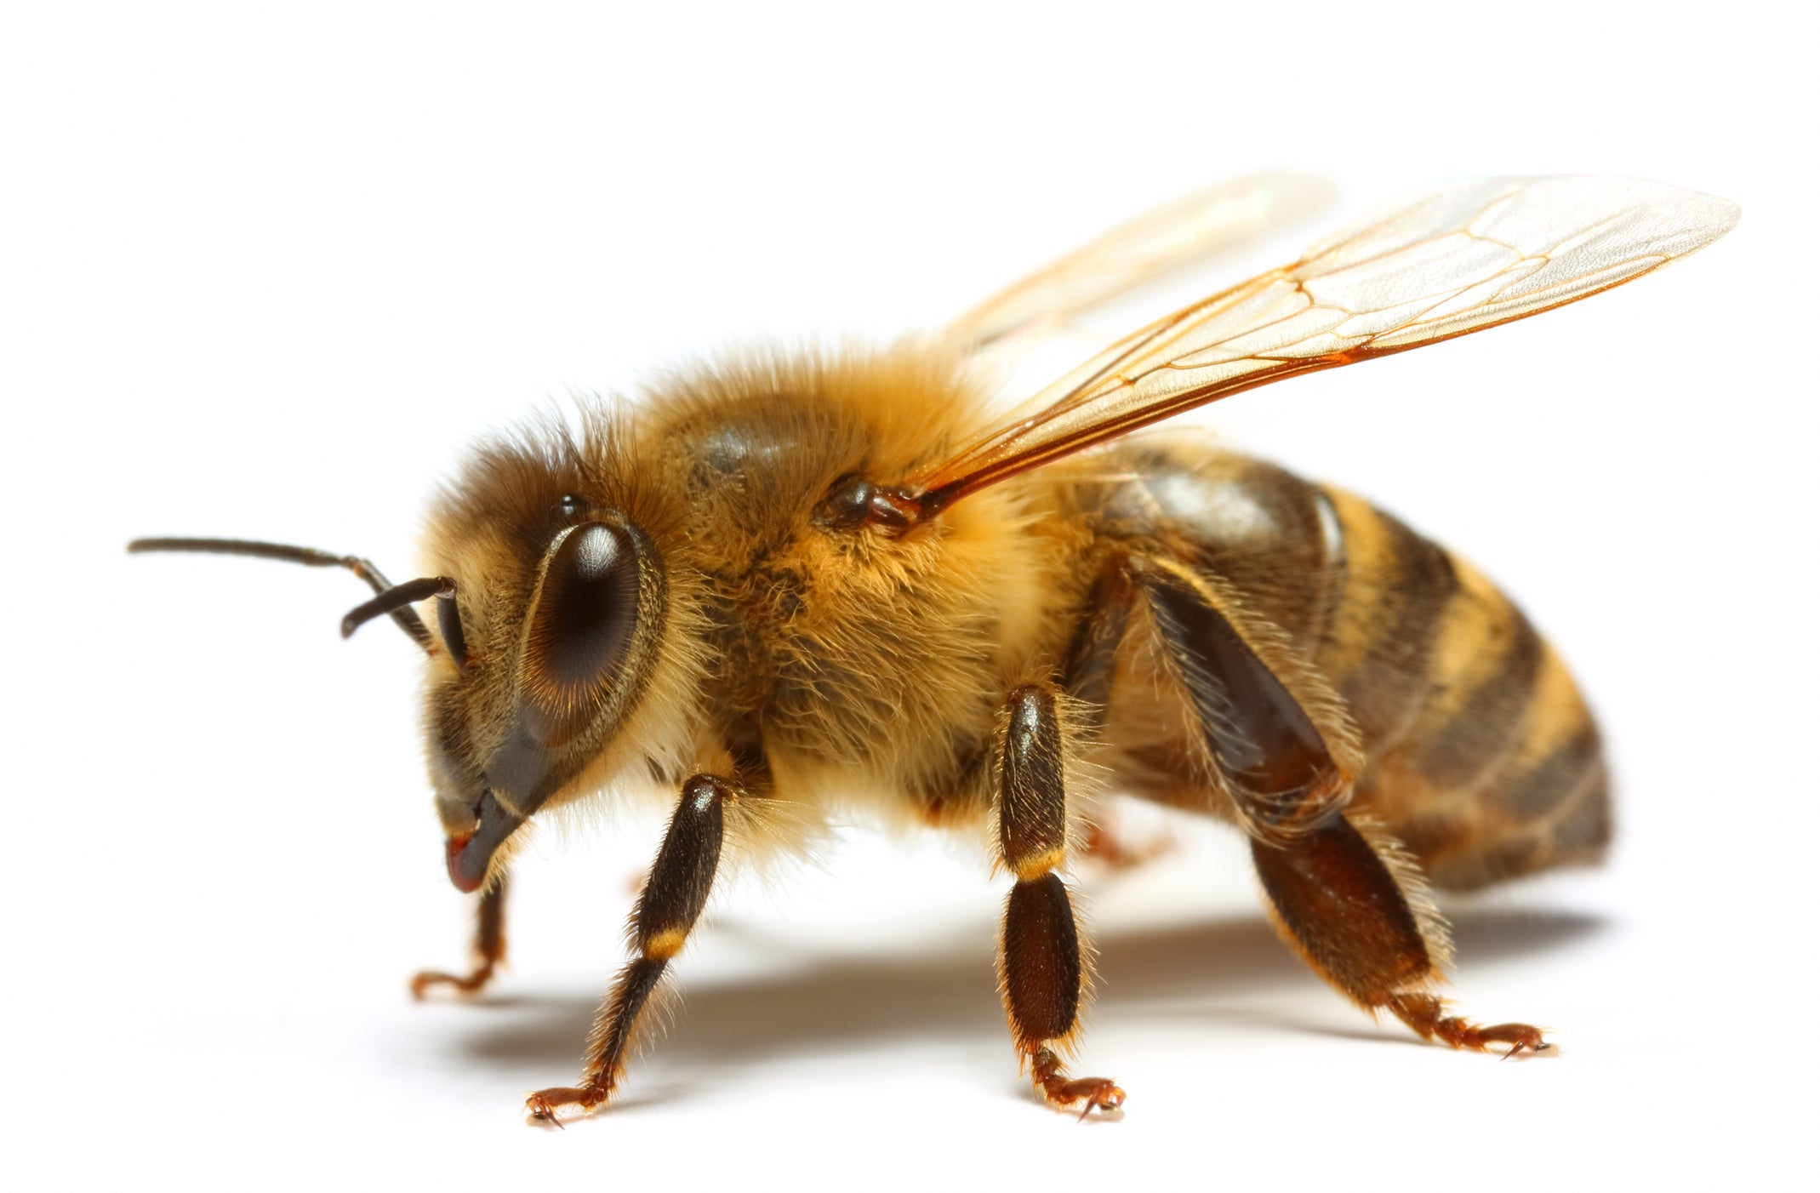
Notes:
See this [wiggle]? This is a bee! Can you tell Maggie what bees are for?

Slide 23
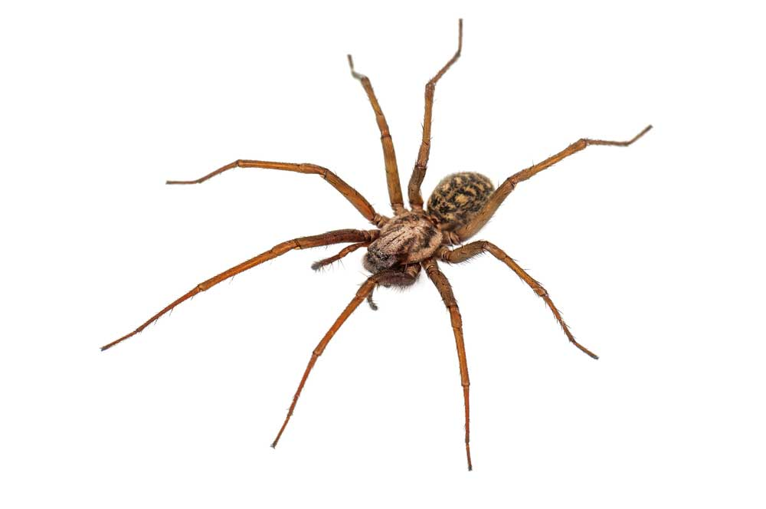
Notes:
See this [wiggle]? This is a spider! Can you tell Maggie what spiders are for?

Slide 24
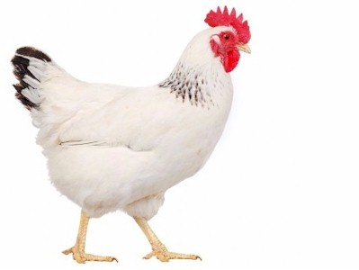
Notes:
See this [wiggle]? This is a chicken! Can you tell Maggie what chickens are for?

Slide 25
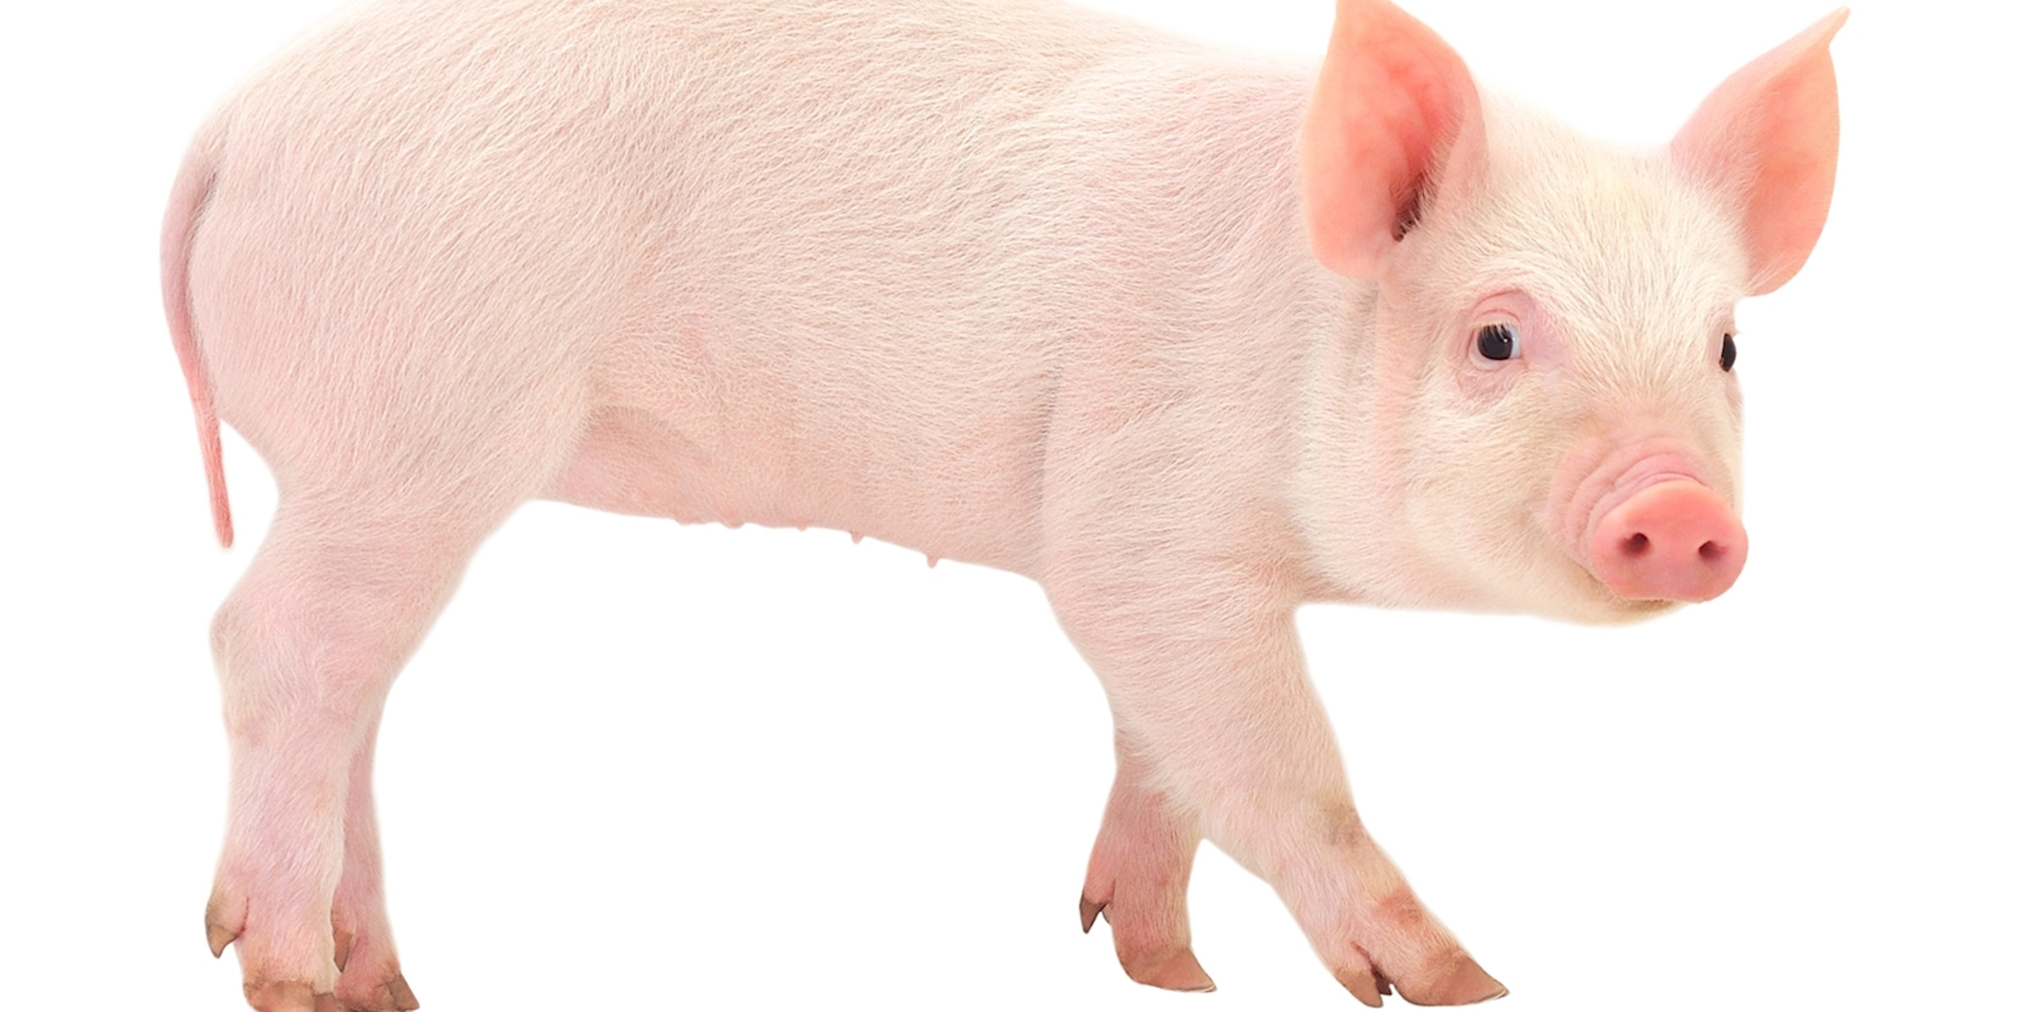
Notes:
See this [wiggle]? This is a pig! Can you tell Maggie what pigs are for?

Slide 26
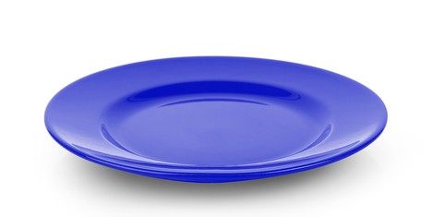
Notes:
See this [wiggle]? This is a plate Can you tell Maggie what plates are for?

Slide 27

Notes:
See this [wiggle]? This is a clock! Can you tell Maggie what clocks are for?

Slide 28
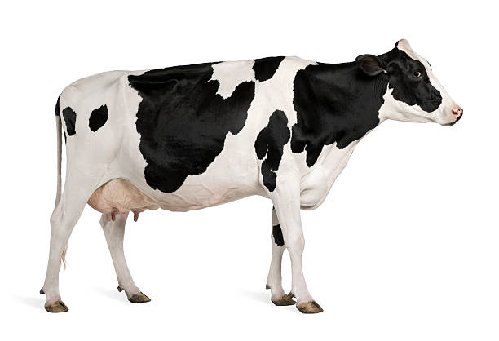
Notes:
See this [wiggle]? This is a cow! Can you tell Maggie what cows are for?

Slide 29
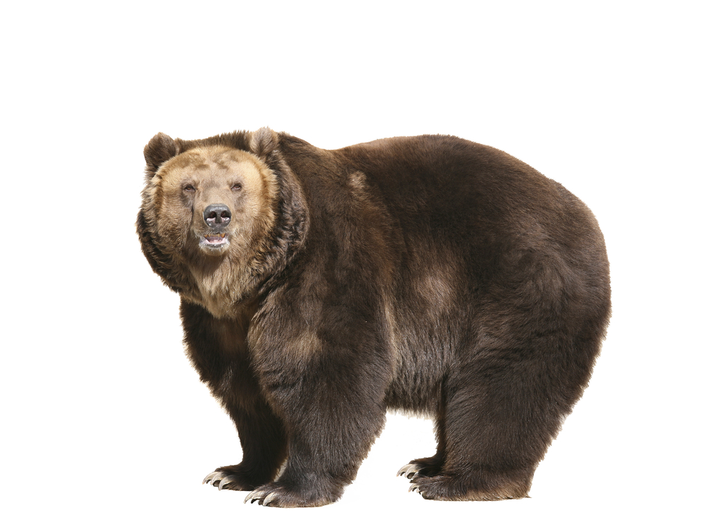
Notes:
See this [wiggle]? This is a bear! Can you tell Maggie what bears are for?

Slide 30
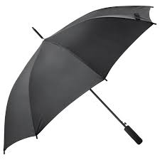
Notes:
See this [wiggle]? This is an umbrella! Can you tell Maggie what umbrellas are for?

Slide 31
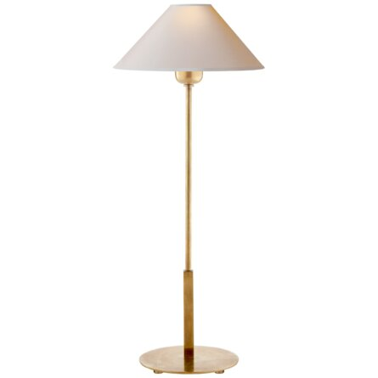
Notes:
See this [wiggle]? This is a lamp! Can you tell Maggie what lamps are for?

Slide 32
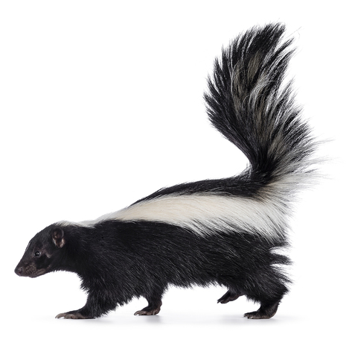
Notes:
See this [wiggle]? This is a skunk! Can you tell Maggie what skunks are for?

Slide 33
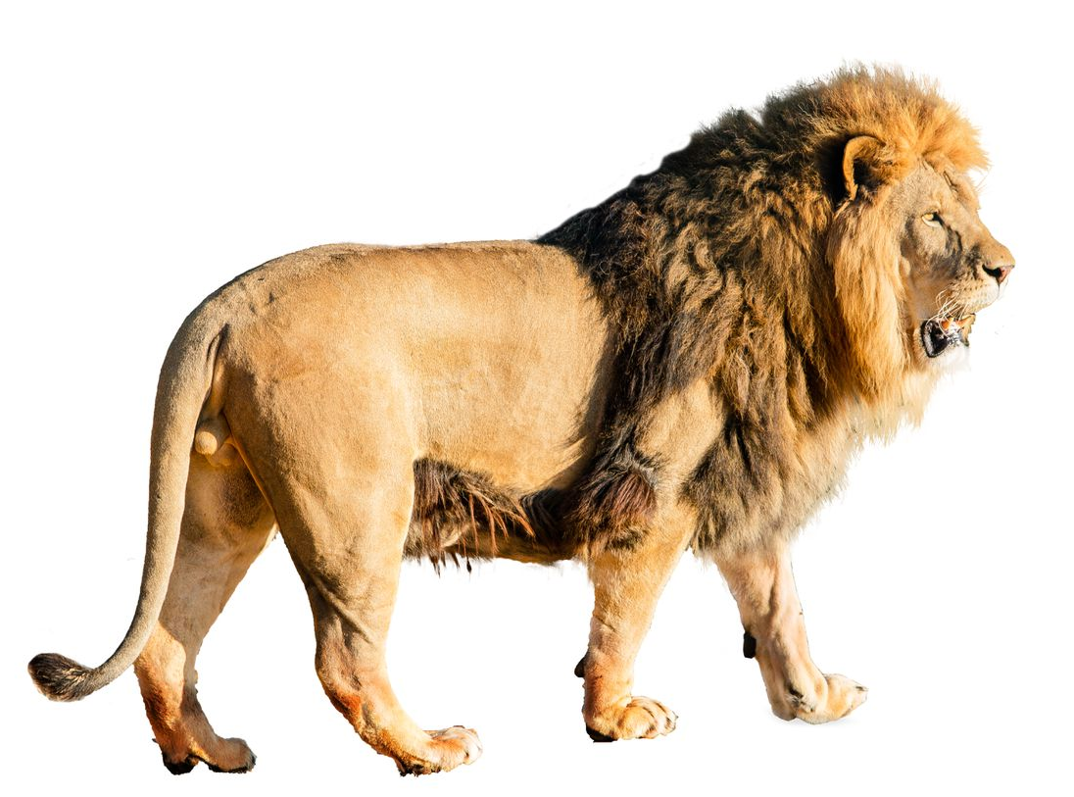
Notes:
See this [wiggle]? This is a lion! Can you tell Maggie what lions are for?

Slide 34
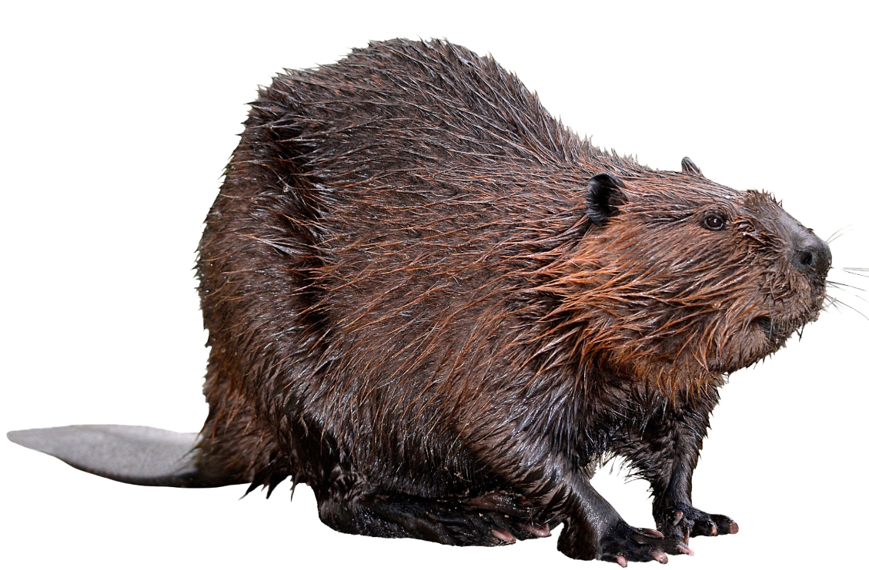
Notes:
See this [wiggle]? This is a beaver! Can you tell Maggie what beavers are for?

Slide 35
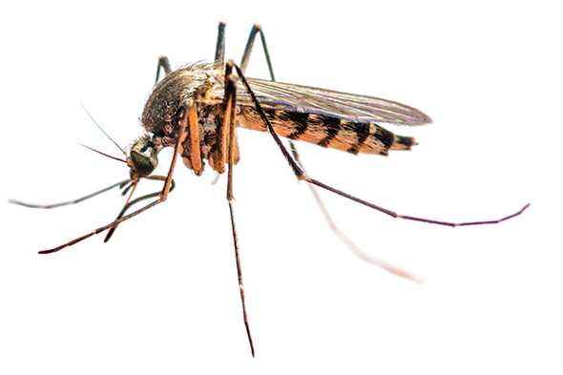
Notes:
See this [wiggle]? This is a mosquito! Can you tell Maggie what mosquitos are for?

Slide 36
Notes:
Thanks so much for helping Maggie! We are about half way done. Do you want to keep helping Maggie? OK great let’s keep helping Maggie!

Slide 37
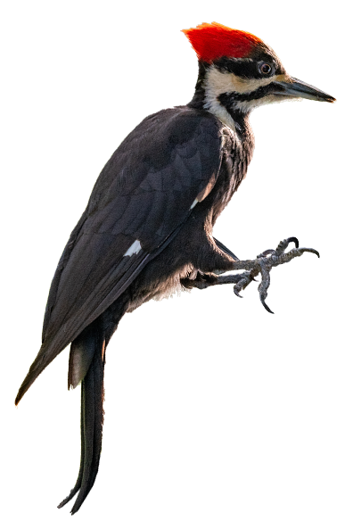
Notes:
See this [wiggle]? This is a woodpecker! Can you tell Maggie what woodpeckers are for?

Slide 38
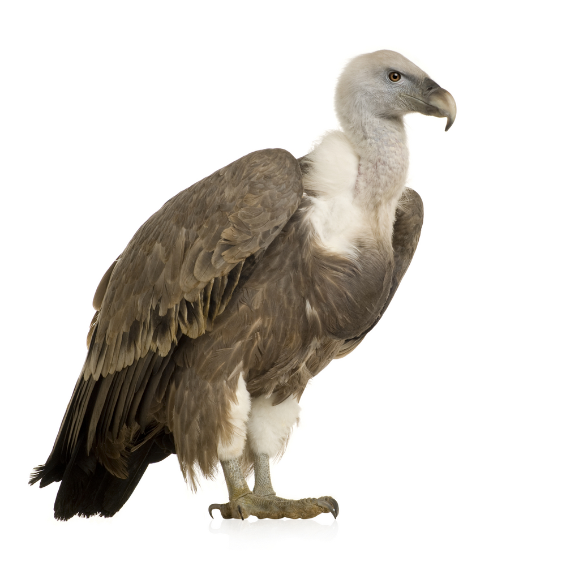
Notes:
See this [wiggle]? This is a vulture! Can you tell Maggie what vultures are for?

Slide 39
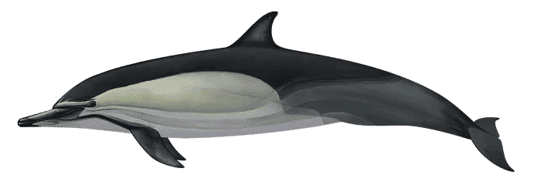
Notes:
See this [wiggle]? This is a dolphin! Can you tell Maggie what dolphins are for?

Slide 40
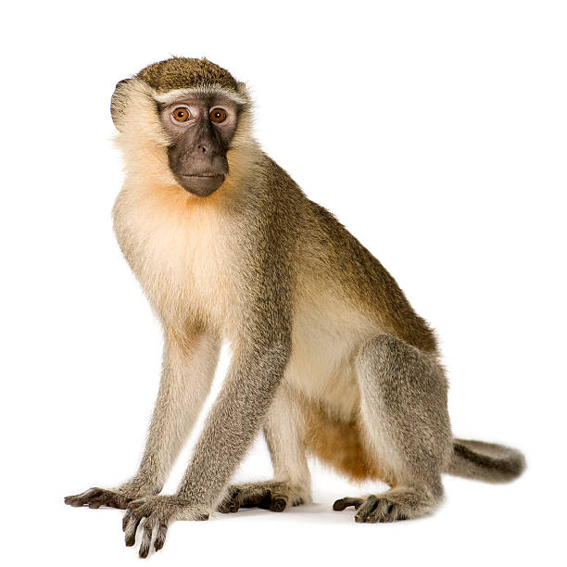
Notes:
See this [wiggle]? This is a monkey! Can you tell Maggie what monkeys are for?

Slide 41
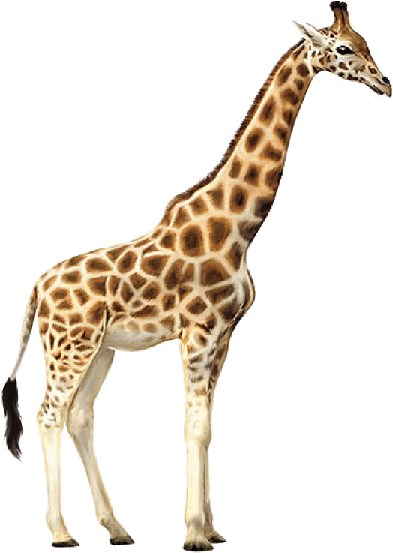
Notes:
See this [wiggle]? This is a giraffe! Can you tell Maggie what giraffes are for?

Slide 42
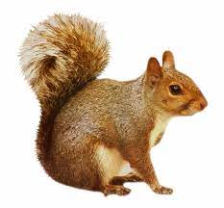
Notes:
See this [wiggle]? This is a squirrel! Can you tell Maggie what squirrels are for?

Slide 43
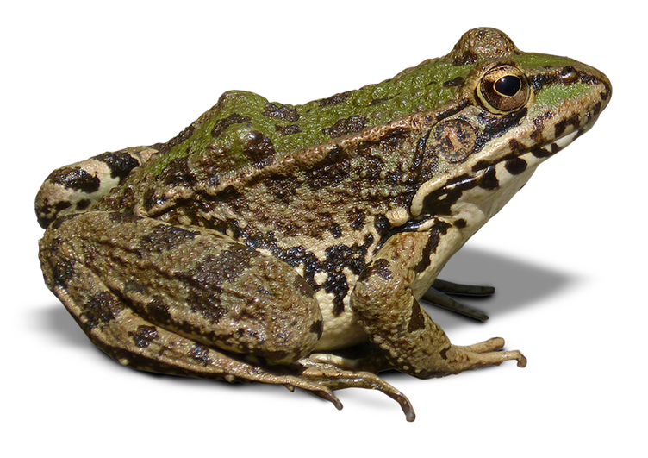
Notes:
See this [wiggle]? This is a frog! Can you tell Maggie what frogs are for?

Slide 44
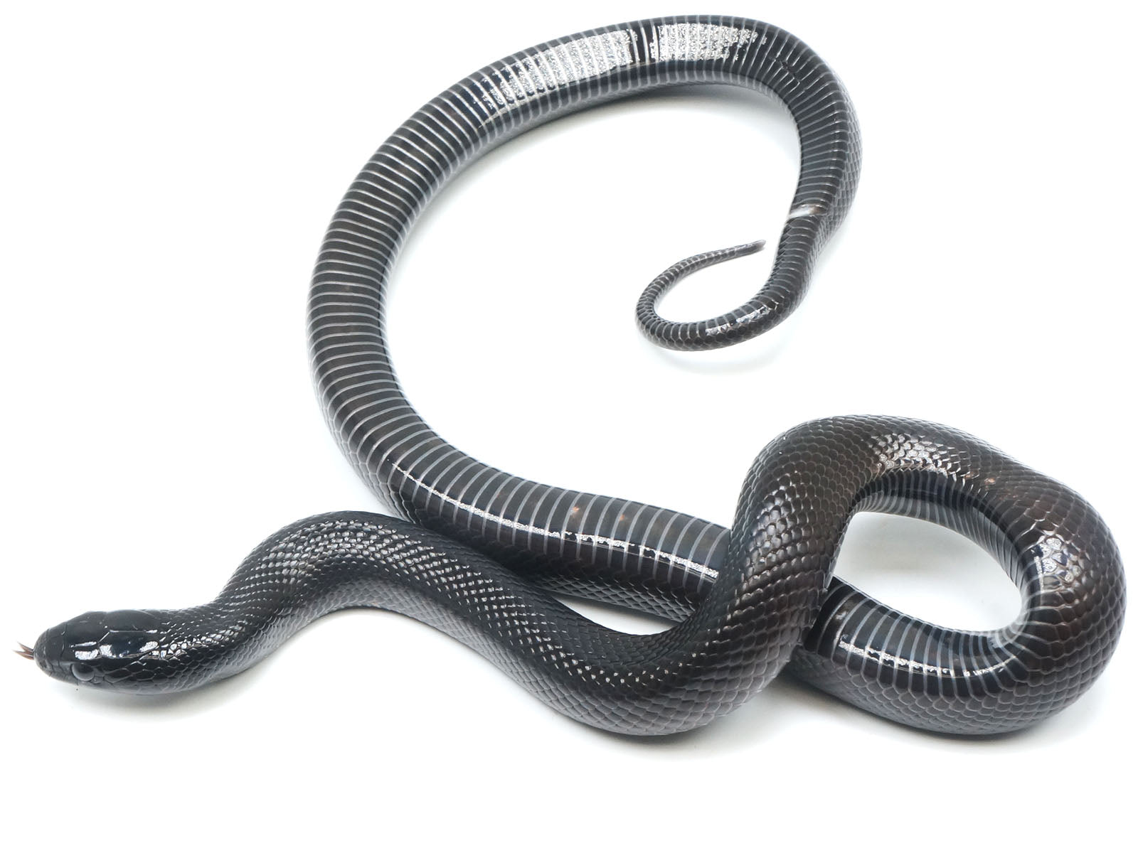
Notes:
See this [wiggle]? This is a snake! Can you tell Maggie what snkaes are for?

Slide 45
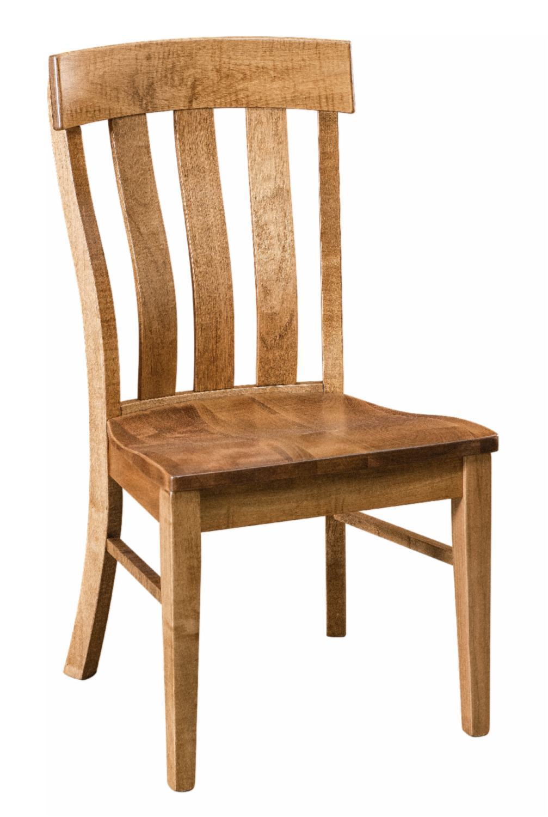
Notes:
See this [wiggle]? This is a chair! Can you tell Maggie what chairs are for?

Slide 46
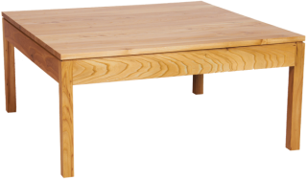
Notes:
See this [wiggle]? This is a table! Can you tell Maggie what tables are for?

Slide 47
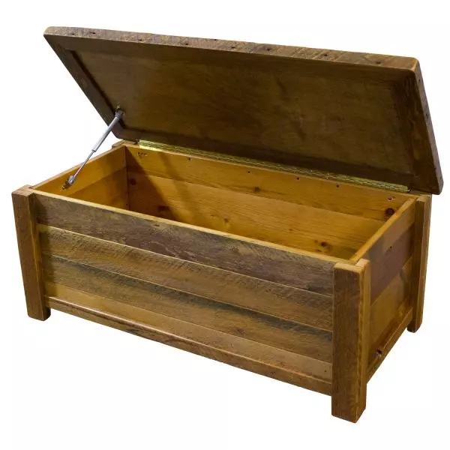
Notes:
See this [wiggle]? This is a toybox! Can you tell Maggie what toyboxes are for?

Slide 48
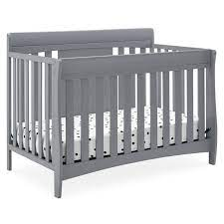
Notes:
See this [wiggle]? This is a baby crib! Can you tell Maggie what wagons are for?

Slide 49
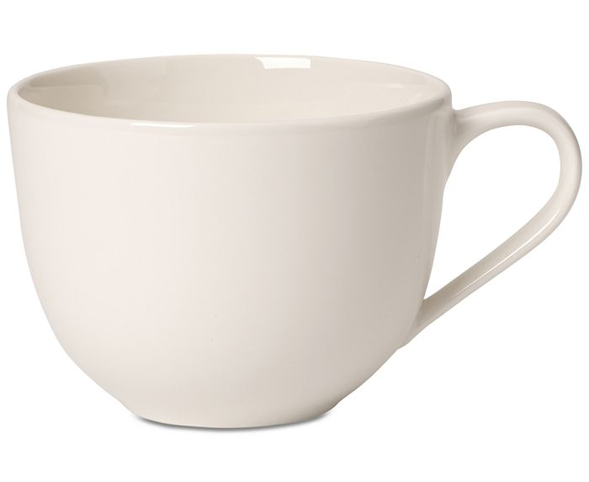
Notes:
See this [wiggle]? This is a cup! Can you tell Maggie what cups are for?

Slide 50
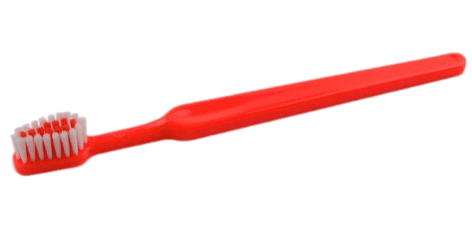
Notes:
See this [wiggle]? This is a toothbrush! Can you tell Maggie what toothbrushes are for?

Slide 51

Notes:
See this [wiggle]? This is a comb! Can you tell Maggie what combs are for?

Slide 52

Notes:
See this [wiggle]? This is a spoon! Can you tell Maggie what spoons are for?

Slide 53
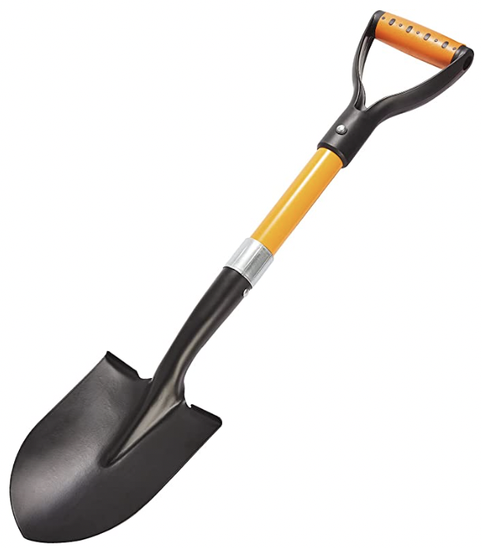
Notes:
See this [wiggle]? This is a shovel! Can you tell Maggie what shovels are for?

Slide 54
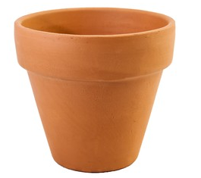
Notes:
See this [wiggle]? This is a flower pot! Can you tell Maggie what flower pots are for?

Slide 55
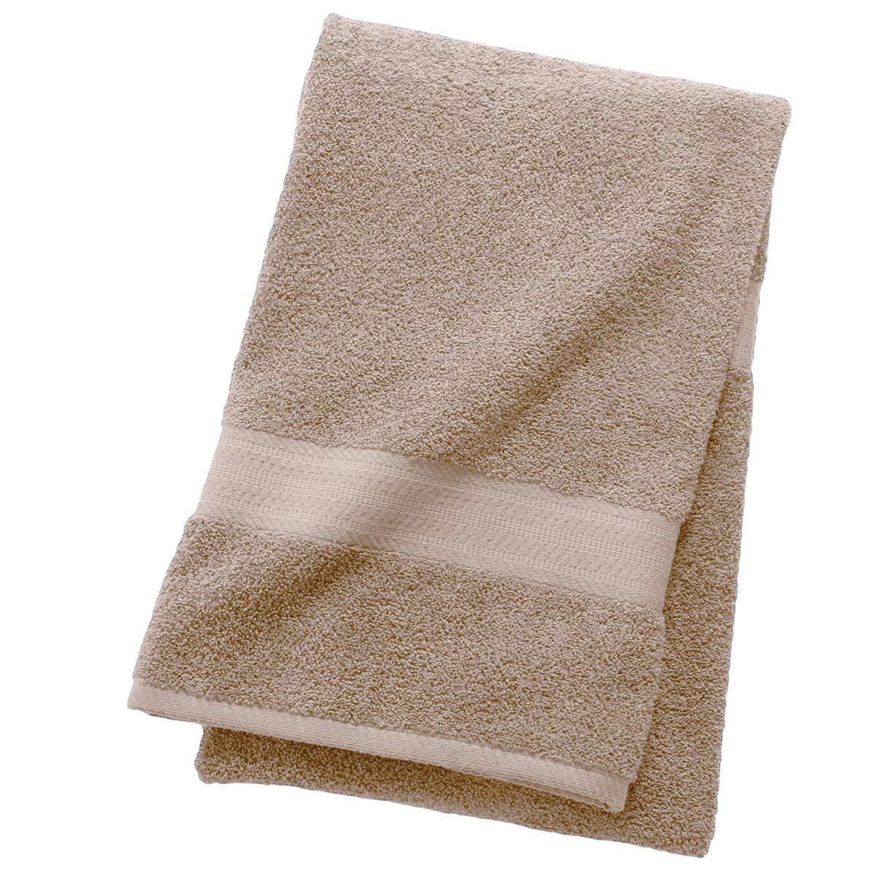
Notes:
See this [wiggle]? This is a towel! Can you tell Maggie what towels are for?

Slide 56
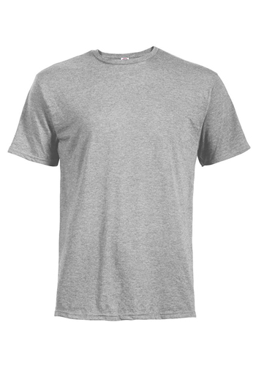
Notes:
See this [wiggle]? This is a shirt! Can you tell Maggie what shorts are for?

Slide 57


THE END
Thank you very much for your participation!

